Slide 1
DMA (Direct memory access)
Farhan Sadaf
Lecturer, Dept. of CSE

Slide 2
Direct memory access
An important aspect governing the Computer System performance is the transfer of data between memory and I/O devices.
The operation involves loading programs or data files from disk into memory, saving file on disk, and accessing virtual memory pages on any secondary storage medium.
Consider a typical system consisting of a CPU, memory and one or more input/output devices. Assume one of the I/O devices is a disk drive and that the computer must load a program from this drive into memory.

Slide 3
Direct memory access
The CPU would read the first byte of the program and then write that byte to memory. Then it would do the same for the second byte, until it had loaded the entire program into memory.
This process proves to be inefficient. Loading data into, and then writing data out of the CPU significantly slows down the transfer. The CPU does not modify the data at all, so it only serves as an additional stop for data on the way to it’s final destination.
The process would be much quicker if we could bypass the CPU & transfer data directly from the I/O device to memory.
Direct Memory Access does exactly that.

Slide 4
Direct memory access
A DMA controller implements direct memory access in a computer system.
It connects directly to the I/O device at one end and the system buses at the other end. It also interacts with the CPU, both via the system buses and two new direct connections.
It is sometimes referred to as a channel. In an alternate configuration, the DMA controller may be incorporated directly into the I/O device.

Slide 5
Direct memory access
Direct memory access (DMA) is a process in which an external device takes over the control of system bus from the CPU.
DMA is for high-speed data transfer from/to mass storage peripherals, e.g. hard disk drive, magnetic tape, CD-ROM, and sometimes video controllers.
The basic idea of DMA is to transfer blocks of data directly between memory and peripherals. The data don’t go through the microprocessor but the data bus is occupied
“Normal” transfer of one data byte takes up to 29 clock cycles. The DMA transfer requires only 5 clock cycles.
Nowadays, DMA can transfer data as fast as 60 M byte per second. The transfer rate is limited by the speed of memory and peripheral devices.

Slide 6
Direct memory access
In a word the DMA controller temporarily borrows the data bus, address bus and control bus from the microprocessor and transfers the data bytes directly from the disk to a series of memory locations.
The data transfer is handled totally in hardware.
It is much faster than it would be if done by program instructions.
A DMA controller can also transfer data from memory to a port.

Slide 7
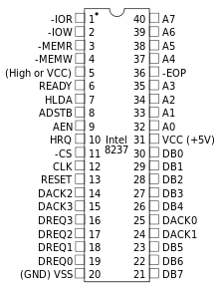
Pin Diagram

Slide 8
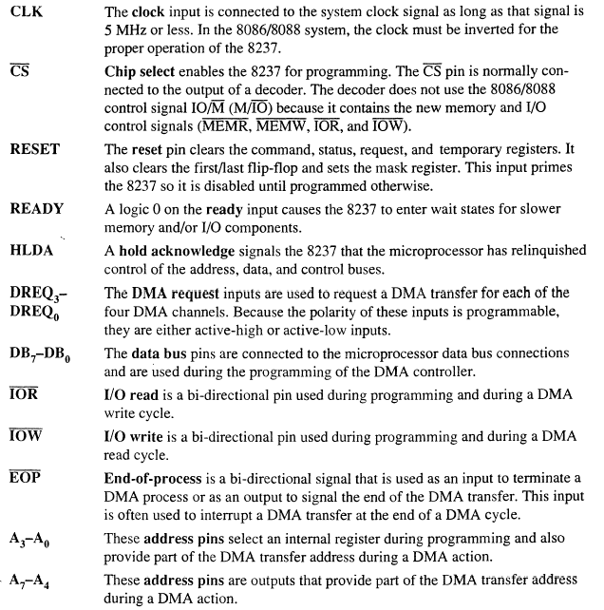

Slide 9
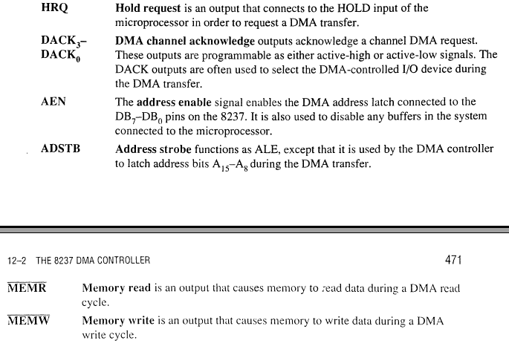

Slide 10
8237 Internal Registers
CAR
The current address register holds a 16-bit memory address used for the DMA transfer.
Each channel has its own current address register for this purpose.
When a byte of data is transferred during a DMA
operation, CAR is either incremented or
is
decremented depending on how it programmed.

Slide 11
CWCR
The current word count register programs a
channel for the number of bytes to transfer during a DMA operation. The number loaded into this register is one less than the number of bytes transferred. For example, if 10 is loaded into the CWCR, then 11 bytes are transferred during DMA action.

Slide 12
CR
The command register programs the operation of the 8237 DMA controller.
The register uses bit position 0 to select the memory-to-memory DMA transfer mode.
Memory-to-memory DMA transfers use DMA channel 0 to hold the source address
DMA channel 1 holds the destination address

Slide 13
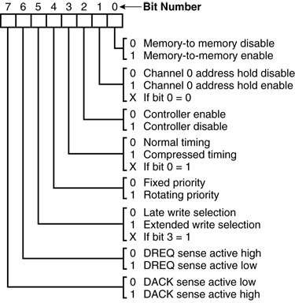
command register.

Slide 14
BA and BWC
The base address (BA) and base word count (BWC) registers are used when auto-initialization is selected for a channel.
In auto-initialization mode, these registers are used to reload the CAR and CWCR after the DMA action is completed.

Slide 15
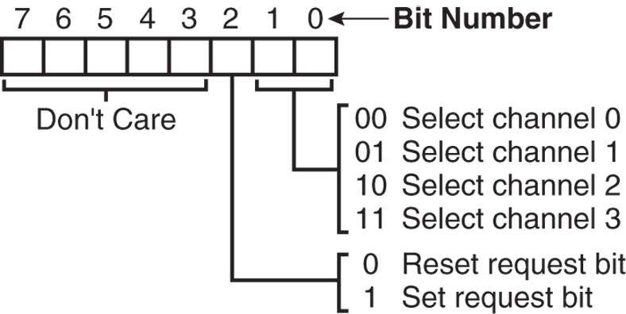
BR
The bus request register is used to request a DMA transfer via software.
very useful in memory-to-memory transfers, where an external signal is not available to begin the DMA transfer

Slide 16
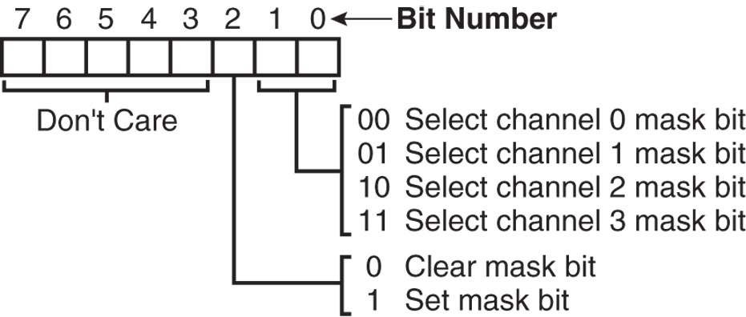
MRSR
The mask register set/reset sets or clears the channel mask.
if the mask is set, the channel is disabled
the RESET signal sets all channel mask to disable them

Slide 17
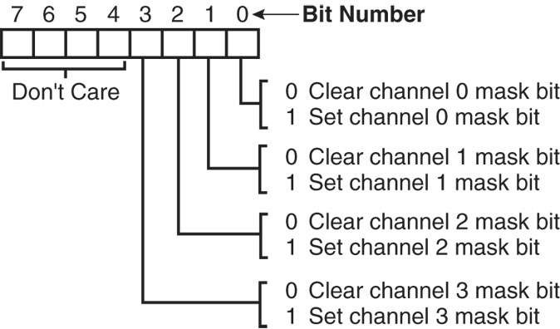
MSR
The mask register clears or sets all of the masks with one command instead of individual channels, as with the MRSR.

Slide 18
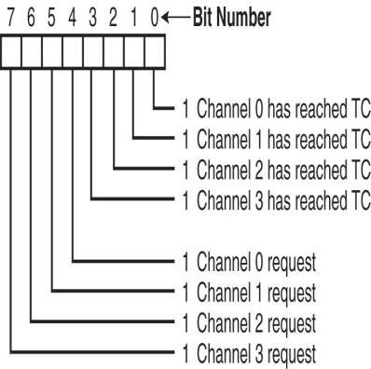
SR
The status register shows status of each DMA channel. The TC bits indicate if the channel has reached its terminal count (transferred all its bytes).
When the terminal count is reached, the DMA transfer is terminated
The request bits indicate whether the DREQ input is given

Slide 19
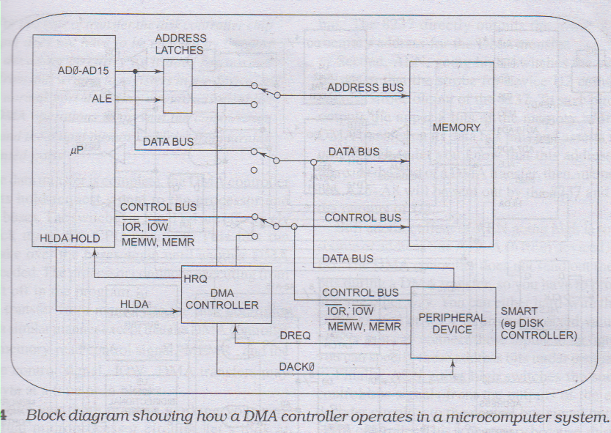
Direct memory access

Slide 20
Direct memory access
When the system is first turned on, the switches are in the up position, so the buses are connected from the microprocessor to system memory and peripherals.
To read a disk file a series of commands is sent to the smart disk controller device, telling it to find and read the desired block of data from the disk.
When the disk controller has the first byte of data from the disk block ready, it sends a DMA request, DREQ, signal to the DMA controller.
If that input of the DMA controller is unmasked, the DMA controller will send a hold-request, HRQ, signal to the microprocessor HOLD input.

Slide 21
Direct memory access
The microprocessor will respond to this input by floating its buses and sending out a hold-acknowledge signal, HLDA. To the DMA controller.
When the DMA controller receives the HLDA signal, it will send out a control signal which throws the three bus switches down to their DMA position.
This disconnects the processor from the buses and connects the DMA controller to the buses.
When the DMA controller gets control of the buses, it sends out the memory address where the first byte of data from the disk controller is to be written.

Slide 22
Direct memory access
Next the DMA controller sends a DMA-acknowledge, DACKO, signal to the disk controller device to tell it to get ready to output the byte.
Finally the DMA controller asserts both the MEMW and the IOR lines on the control bus.
The byte of data then is transferred directly from the disk controller to the memory location without passing through the CPU or the DMA controller.
When the data transfer is complete, the DMA controller unasserts its hold-request signal to the processor and releases the buses.

Slide 23
Direct memory access
A DMA transfer from memory to the disk controller proceeds in a similar manner except that the DMA controller asserts the memory-read control signal, MEMR and the output-write control signal, IOW.

Slide 24
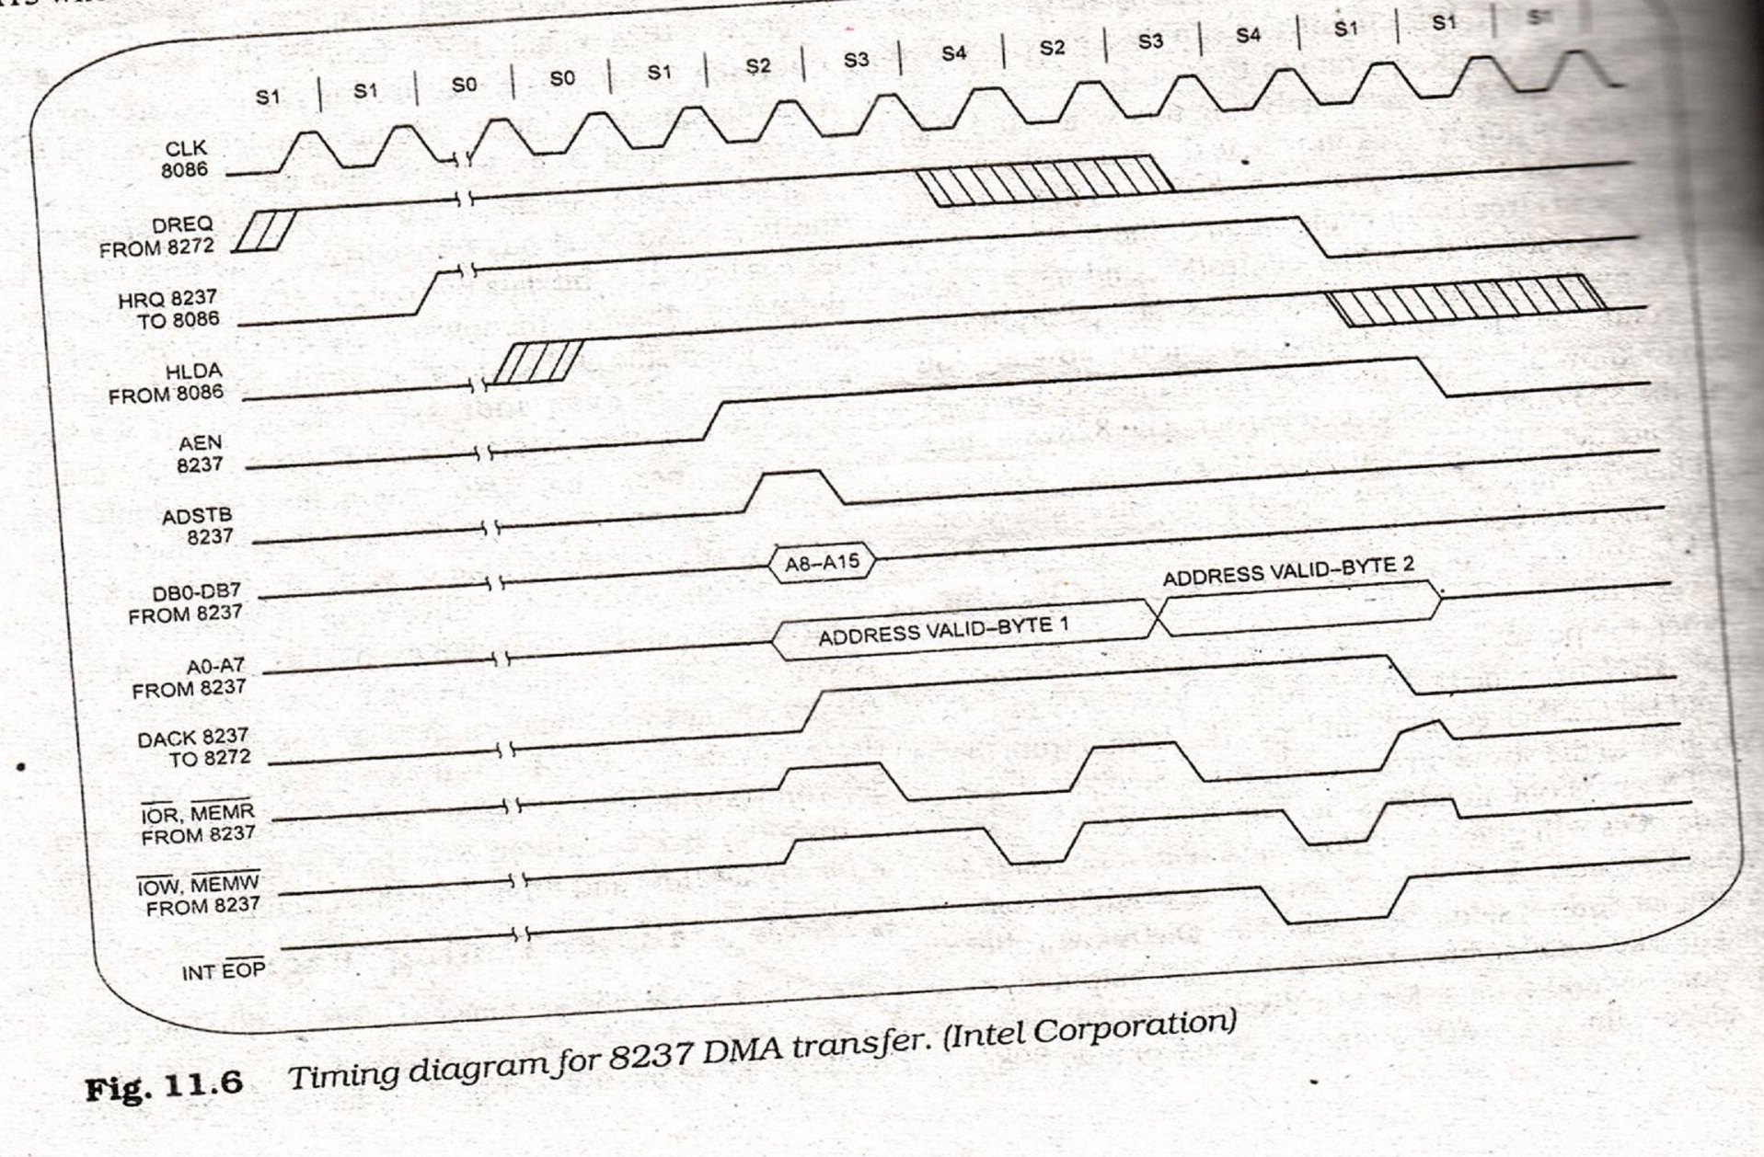
DMA TRANSFER TIMING DIAGRAM

Slide 25
DMA TRANSFER TIMING DIAGRAM
See the details from Book Chapter 11 (D.V. Hall)

Slide 26
Thank You

